Slide 1

Demand
&
Supply

Slide 2
Demand
The market we are going to examine is highly competitive with many competing firms and many consumers. This means that firms and consumers are price takers

Slide 3
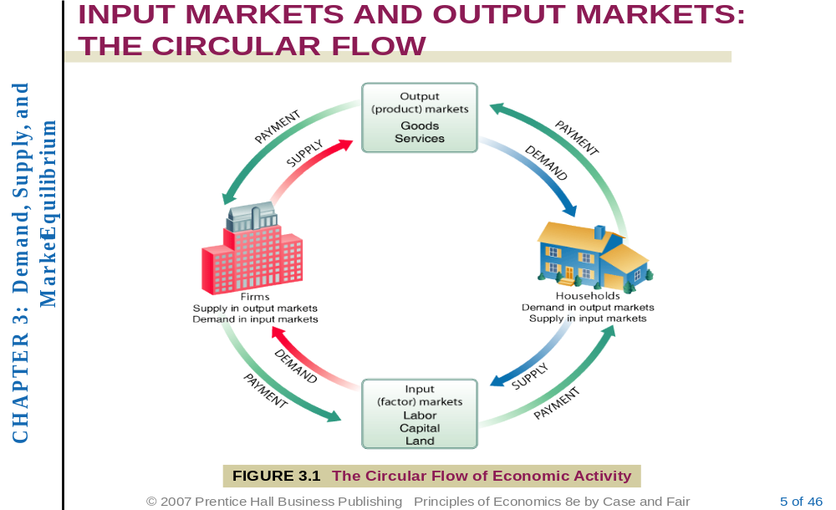
THE CIRCULAR FLOW

Slide 4
Demand
Demand is the quantity of a good or service that consumers are willing and able to buy at various prices in a given period of time.
Though there are several factors that determine a consumers decision to buy a commodity, we define demand as a relationship between quantity and price. Price determines the relative value of a commodity and thus the most important determinant of demand

Slide 5
The Law of Demand
The law of demand states that:
There is a an inverse relationship between quantity demanded of a commodity and its price. Thus:
“Other things unchanged, as price rises, the quantity demanded decreases, and as price falls, the quantity demanded increases”

Slide 6
Exceptions to the law of demand
Generally, the amount demanded of good increases with a decrease in price of the good and vice versa. In some cases, however, this may not be true. Such situations are:
Giffen Goods
Commodities which are used as status symbols

Slide 7
Reasons behind the law of Demand
Relationship between demand and price can be explained by:
  The Income Effect
  The Substitution Effect
Notes:
2

Slide 8
Income and Substitution Effects
Income Effect:
When the price of a commodity rises, the consumer would feel poorer as real income falls and thus would buy less and vice versa.
Substitution Effect:
When the price of a commodity rises, the good would now cost more than its alternatives or substitutes and thus consumers would switch to the alternatives. The opposite is true for a fall in price

Slide 9
Demand Schedule, Demand Curve and Demand Function
The negative relationship between price and quantity demanded can be presented by a demand schedule, demand curve and/or demand function.

Slide 10
Demand Schedule
A demand schedule is a table showing how much of a given product a household would be willing to buy at different prices.

Slide 11
Demand Schedule
Price Per Unit | Quantity of Potatoes
20 | 700
40 | 500
60 | 350
80 | 200
100 | 100
120 | 50
140 | 10
160 | 0

Slide 12
Demand Curve
The demand curve is a graph showing the relationship between price of a good and quantity of the good demanded over a given time period.
According to convention, the demand curve is drawn with price on the vertical axis and quantity on the horizontal axis. A demand curve shows the relationship between price and quantity demanded only; all (other) factors affecting demand are assumed to remain unchanged along a demand curve.

Slide 13
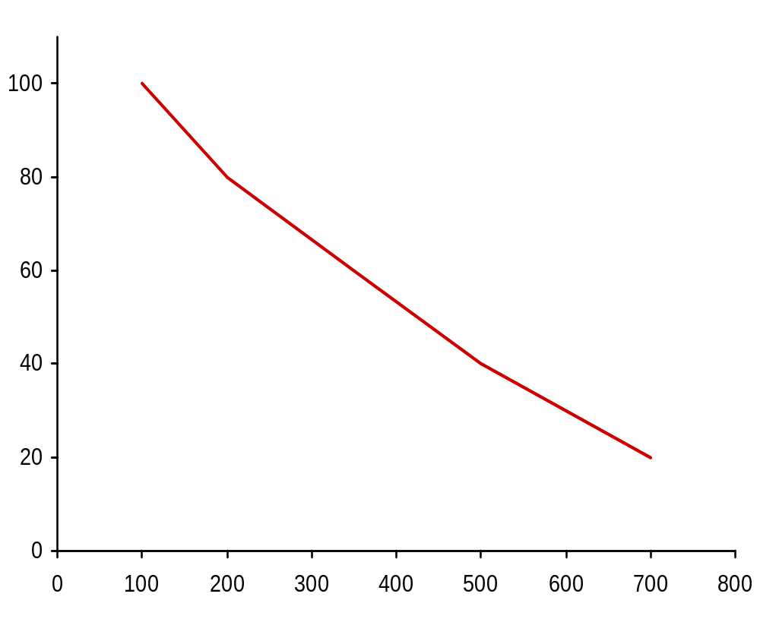

Demand Curve for potatoes (monthly)
E
Point
Price
(pence per kg)
20
40
60
80
100
Market demand
(tonnes 000s)
700
500
350
200
100
A
B
C
D
E
D
C
Price (pence per kg)
B
A
Demand
Quantity (tonnes: 000s)

Slide 14
Three Properties of the Demand Curve
  First, the demand curve is negatively sloped which reflects the law of demand. An increase in price is likely to lead to a decrease in quantity demanded, and a decrease in price is likely to lead to an increase in quantity demanded.
  They intersect the price (Y) axis, a result of limited incomes and wealth. That is As long as households have limited incomes and wealth, all demand curves will intersect the price axis. For any commodity, there is always a price above which a household will not or cannot pay. Even if the good or service is very important, all households are ultimately constrained, or limited, by income and wealth.

Slide 15
Three Properties of the Demand Curve (Con’t)
The third property is that demand curves intersect the quantity axis is a matter of common sense. Demand in a given period of time is limited, if only by time, even at a zero price. In other words They intersect the quantity (X-) axis, a result of time limitations and diminishing marginal utility.

Slide 16
Demand
Other determinants of demand
  tastes
  number and price of related goods
  income
  distribution of income
  expectations
Notes:
3

Slide 17
Changes in Demand versus Changes in Quantity Demanded
A change in price, ceteris paribus, results in a change in quantity demanded; that is a movement along the curve not a change in demand.
A change in demand (curve) results from changes in factors other than price. Such changes cause shifts of the demand curve.

Slide 18
Change in Demand and change in quantity demanded
Movements along and shifts in the demand curve
  change in price
    ⇒ movement along Demand curve
  change in any other determinant of demand
    ⇒ shift in D curve
      increase in demand ⇒ rightward shift
      decrease in demand ⇒ leftward shift
Notes:
3

Slide 19
Factors causing changes (shifts) in demand (curve):
Changes in income
Taste
prices of related goods (substitutes or complementary goods)
expectations about future prices,
number of buyers
Other non-self-price factors

Slide 20
Change in Quantity Demanded
P
A
20
B
10
100
200
Q
Notes:
3

Slide 21
An increase in demand
  Possible causes of a rise in demand
  Tastes shift towards this product
  Rise in price of substitute goods
  Fall in price of complementary goods
  Rise in income
  Expectations of a rise in price
P
Price
D₀
D₁
O
Q₀
Q₁
Quantity

Slide 22
A Decrease in demand
  Possible causes of a fall in demand
  Tastes shift against this product
  Fall in price of substitute goods
  Rise in price of complementary goods
  Fall in income
  Expectations of a fall in price
P
Price
D₁
D₀
O
Q₀
Q₁
Quantity

Slide 23
Which way will the market demand for petrol shift if the price of cars rises?
Q
Right
Left
No shift (movement along the curve)

Slide 24
Which way will the market demand for petrol shift if petrol becomes more expensive
Q
Right
Left
No shift (movement along the curve)

Slide 25
The effect on the margarine market of a reduction in butter prices would be to:
Q
increase the price of margarine by an identical amount.
leave the demand for margarine unaffected.
decrease the demand for margarine at all prices.
increase the demand for margarine at all prices.
shift the supply of margarine to the left.

Slide 26
Demand Function
The demand function is the mathematical expression of the relationship between the quantity of a good demanded and those factors that affect the willingness and ability of a consumer to buy the good
simple demand functions
    Q_{d} = a – bP
  more complex demand functions
    Q_{d} = a – bP + cY + dP_{s} – ePc
Notes:
3

Slide 27
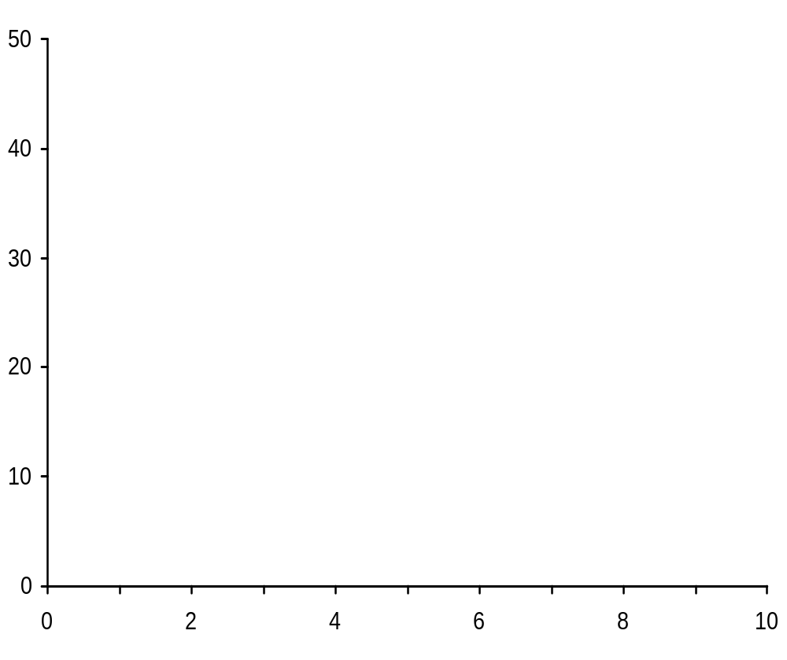
Demand curve for equation: Q_{d} = 10 000 – 200P
P
D
Q (000s)

Slide 28
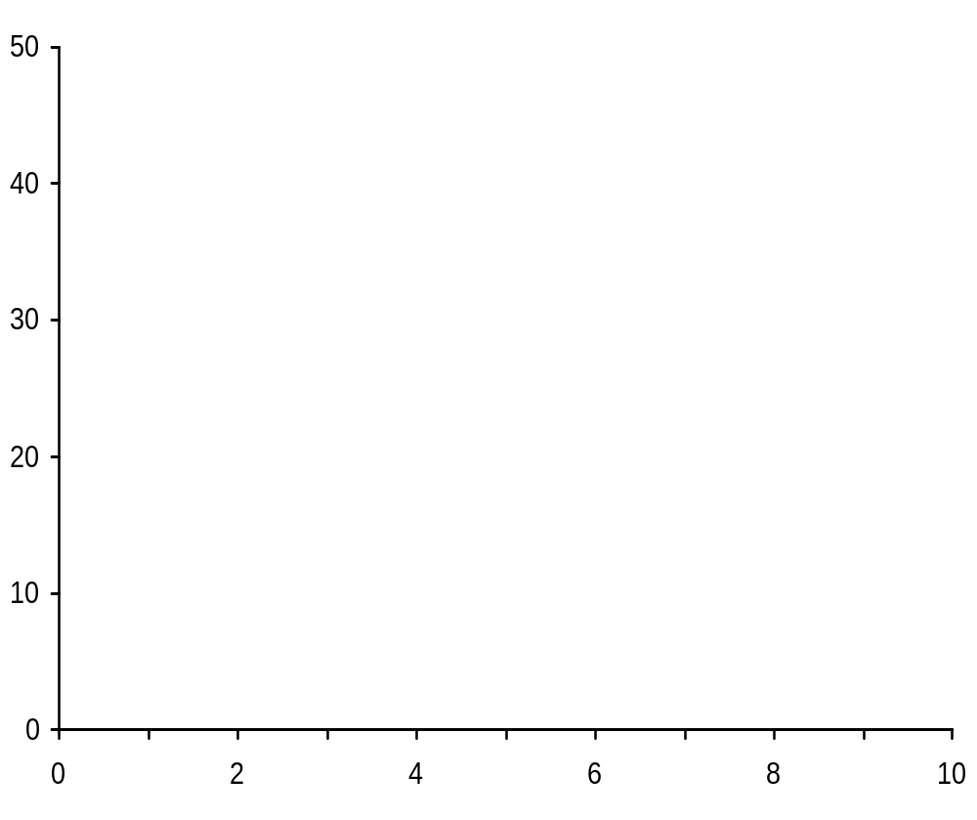
Demand curve for equation: Q_{d} = 10 000 – 200P
P
5
Q_{d} (000s)
9
P
D
Q (000s)

Slide 29
Demand curve for equation: Q_{d} = 10 000 – 200P
P
5
10
Q_{d} (000s)
9
8
P
D
Q (000s)

Slide 30
Demand curve for equation: Q_{d} = 10 000 – 200P
P
5
10
15
Q_{d} (000s)
9
8
7
P
D
Q (000s)

Slide 31
Demand curve for equation: Q_{d} = 10 000 – 200P
P
5
10
15
20
Q_{d} (000s)
9
8
7
6
P
D
Q (000s)

Slide 32
Market Demand Verses Individual Demand
Market demand: Sum of individual Demands for the particular good

Slide 33
Supply
Definition: Supply is the amount of a particular product that a firm would be willing and able to offer for sale at a particular price during a given time period.

Slide 34
The law of Supply
The law of supply postulates a positive relationship between price and quantity of a good supplied:
It States that: “An increase in market price will lead to an increase in quantity supplied, and a decrease in market price will lead to a decrease in quantity supplied, all other things being equal”.

Slide 35
Reasons Behind the Law of Supply
As firms increase production beyond a point, the production cost rises more rapidly and thus firms would only increase production and supply if they can get higher price for the commodity.
Higher prices make the production of a commodity more profitable. This means that as price rises, firms would produce more to take advantage of the higher price to increase profits.
Increase in price encourage new entrants into the market to take advantage of higher potential profits thereby increasing market supply
Notes:
4

Slide 36
Supply Schedule, Supply Curve, and Supply Function
The relationship between price and quantity supplied of a commodity can be expressed in three way. These are: supply Schedule, Supply Curve, and Supply Function

Slide 37
Supply Schedule
Supply schedule is a table which shows how much one or more firms will be willing to supply at particular prices. The supply schedule shows the quantity of goods that a supplier would be willing and able to sell at specific prices under the existing circumstances.

Slide 38
Supply Curve
The supply curve is a graph that shows the amount of some good that producers are willing and able to sell at various prices, assuming ceteris paribus, that is, assuming all determinants of supply other than the price of the good in question, such as technology and the prices of factors of production, remain the same. The supply curve usually slopes upward, since higher prices give producers an incentive to supply more in the hope of making greater revenue.

Slide 39
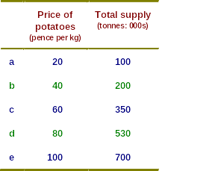
The supply Schedule:
The supply of potatoes (monthly)

Slide 40
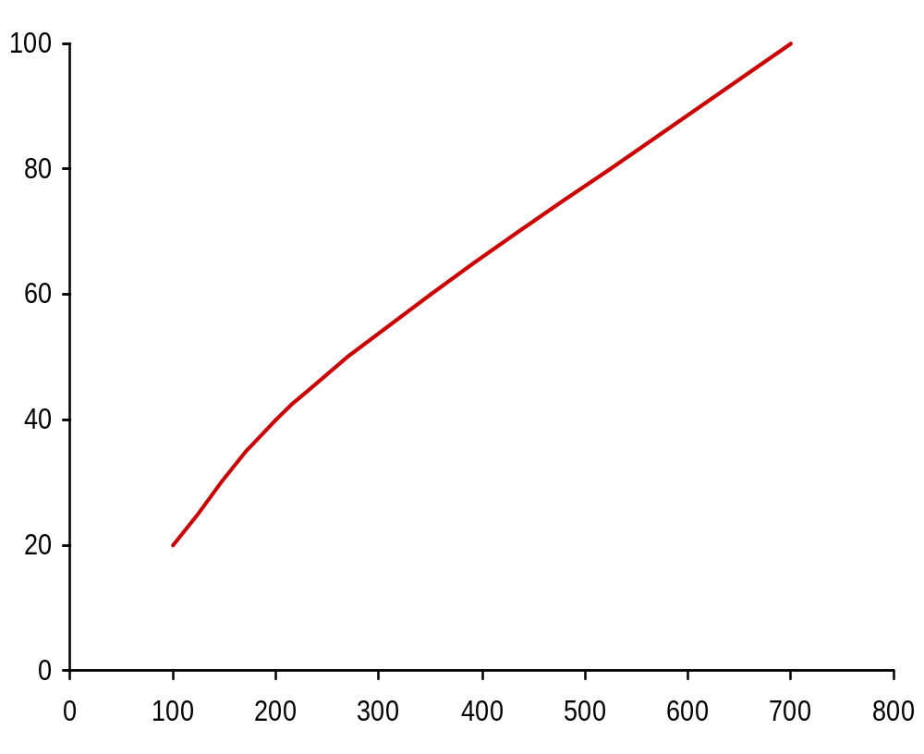
Market supply of potatoes (monthly)
Supply
P
20
Q
100
a
Price (pence per kg)
a
Quantity (tonnes: 000s)

Slide 41
Market supply of potatoes (monthly)
Supply
P
20
40
Q
100
200
a
b
Price (pence per kg)
b
a
Quantity (tonnes: 000s)

Slide 42
Market supply of potatoes (monthly)
Supply
P
20
40
60
Q
100
200
350
a
b
c
c
Price (pence per kg)
b
a
Quantity (tonnes: 000s)

Slide 43
Market supply of potatoes (monthly)
Supply
d
P
20
40
60
80
Q
100
200
350
530
a
b
c
d
c
Price (pence per kg)
b
a
Quantity (tonnes: 000s)

Slide 44
Market supply of potatoes (monthly)
e
Supply
d
P
20
40
60
80
100
Q
100
200
350
530
700
a
b
c
d
e
c
Price (pence per kg)
b
a
Quantity (tonnes: 000s)

Slide 45
Supply
Other determinants of supply
  costs of production
  profitability of alternative products (substitutes in supply)
  profitability of goods in joint supply
  nature and other random shocks
  aims of producers
  expectations of producers
Notes:
4

Slide 46
Supply
Movements along and shifts in the supply curve
  change in price
    ⇒ movement along S curve
  change in any other determinant of supply
    ⇒ shift in S curve
      increase in supply ⇒ rightward shift
      decrease in supply ⇒ leftward shift
Notes:
5

Slide 47
Supply
Supply functions
  simple supply functions
    Q_{s} = a + bP
  more complex supply functions
    Q_{s} = a + bP + cC + dP_{s} – eP_{j}
  non-linear functions
  estimated supply equations
  problems of estimating supply equations
Notes:
3

Slide 48
Shifts in the supply curve
P
  Possible causes of a rise in supply
  Fall in costs of production
  Reduced profitability of alternative products that could be supplied
  Increased profitability of goods in joint supply
  Benign shocks
  Expectations of a fall in price
S₀
S₁
Increase
O
Q

Slide 49
Shifts in the supply curve
P
S₂
S₀
S₁
Decrease
Increase
O
Q

Slide 50
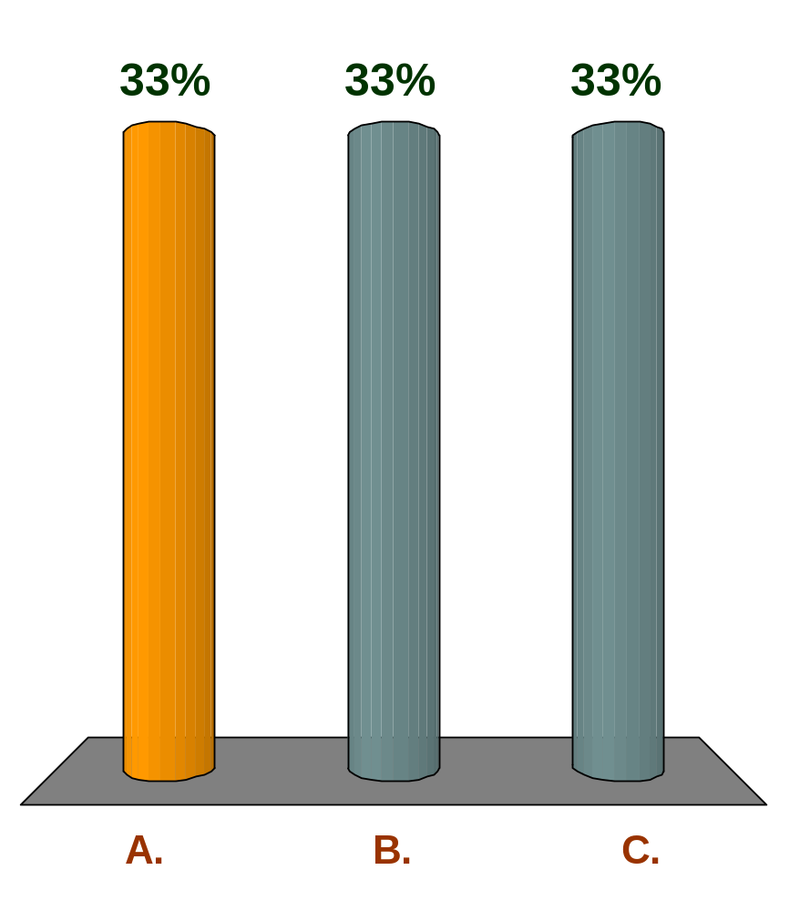
Which way will the market supply of bread shift if the price of flour falls?
Q
Right
Left
No shift (movement along the curve)

Slide 51
Supply and Demand
Price and output determination

Slide 52
Price and output determination
Equilibrium price and output
  response to shortages and surpluses
    shortage (D > S)
      ⇒ price rises
    surplus (S > D)
      ⇒ price falls
  significance of ‘equilibrium’
Notes:
7

Slide 53
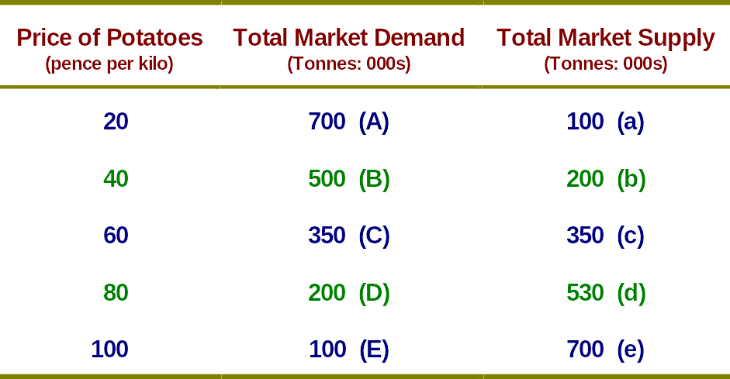
Equilibrium price and output:
The Market Demand and Supply of Potatoes (Monthly)

Slide 54
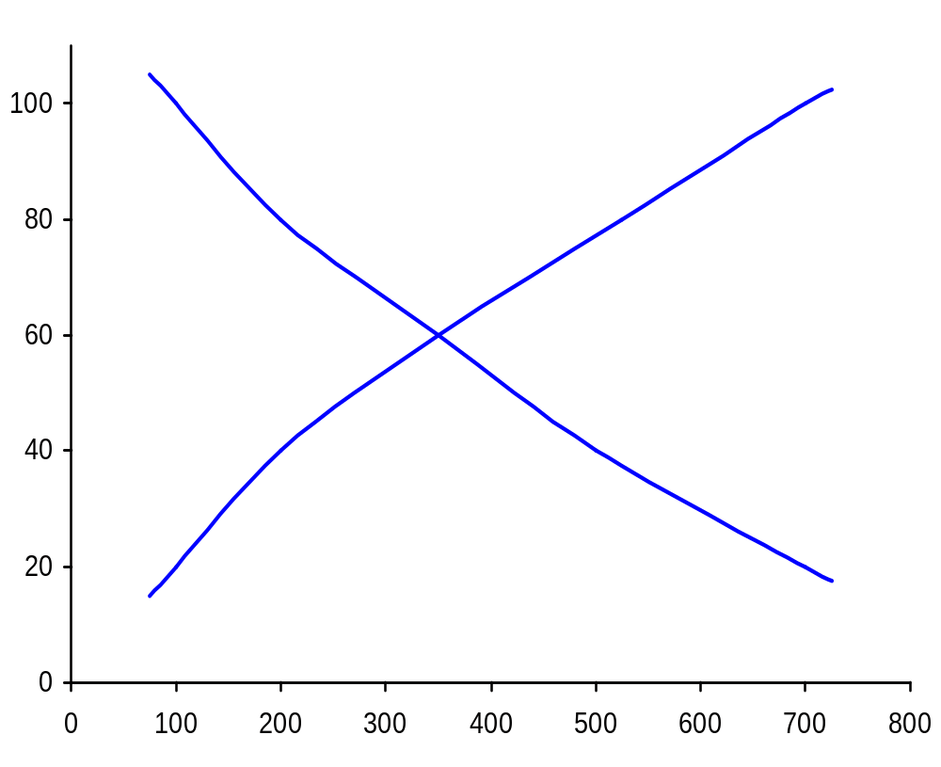
The determination of market equilibrium
(potatoes: monthly)
E
e
Supply
D
d
C
c
Price (pence per kg)
b
B
a
A
Demand
Quantity (tonnes: 000s)

Slide 55
The determination of market equilibrium
(potatoes: monthly)
E
e
Supply
D
d
C
c
Price (pence per kg)
b
SHORTAGE
B
(300 000)
a
A
Demand
Quantity (tonnes: 000s)

Slide 56
The determination of market equilibrium
(potatoes: monthly)
E
e
Supply
D
SURPLUS
d
(330 000)
C
c
Price (pence per kg)
b
B
a
A
Demand
Quantity (tonnes: 000s)

Slide 57
The determination of market equilibrium
(potatoes: monthly)
E
e
Supply
D
d
Price (pence per kg)
b
B
a
A
Demand
Q_{e}
Quantity (tonnes: 000s)

Slide 58
Price and output determination
Effects of shifts in the demand curve
  If any of the determinants of demand changes (other than price) the whole of the demand curve shifts.
  This will mean a movement along the supply curve and the new demand curve.
Notes:
7

Slide 59
Effect of a shift in the demand curve
P
S
Initial equilibrium at point g
g
P_{e1}
D₁
O
Q_{e1}
Q

Slide 60
Effect of a shift in the demand curve
P
S
g
P_{e1}
D₁
O
Q_{e1}
Q

Slide 61
Effect of a shift in the demand curve
P
S
g
P_{e1}
D₂
D₁
O
Q_{e1}
Q

Slide 62
Effect of a shift in the demand curve
P
S
i
New equilibrium at point i
P_{e2}
g
h
P_{e1}
D₂
D₁
O
Q_{e1}
Q_{e2}
Q

Slide 63
Price and output determination
Effects of shifts in the supply curve
  Just like the demand , if there is a change in the determinants of supply (other than price) the whole supply curve shifts.
  This causes movement along demand curve and new supply curve.
  Assume that there is increase in taxes, this will cause a decrease in supply as shown below:
Notes:
7

Slide 64
Effect of a shift in the supply curve
P
S₁
g
Initial equilibrium at point g
P_{e1}
D
O
Q_{e1}
Q

Slide 65
Effect of a shift in the supply curve
P
S₁
g
P_{e1}
D
O
Q_{e1}
Q

Slide 66
Effect of a shift in the supply curve
P
S₂
S₁
g
P_{e1}
D
O
Q_{e1}
Q

Slide 67
Effect of a shift in the supply curve
P
S₂
S₁
k
P_{e3}
j
g
New equilibrium at point k
P_{e1}
D
O
Q_{e3}
Q_{e1}
Q

Slide 68
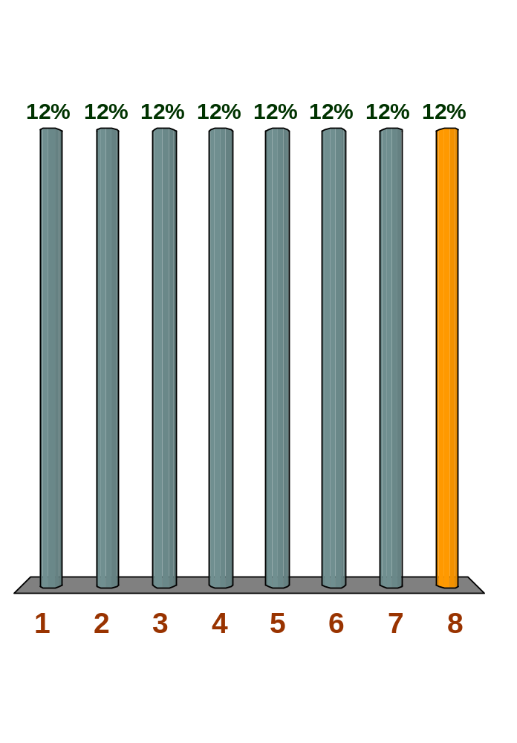
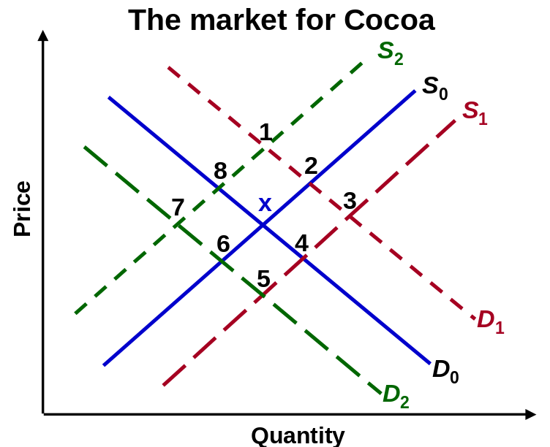
Q The diagram shows the market for cocoa. Equilibrium is currently at point x. To which equilibrium point
(1, 2, 3, 4, 5, 6, 7 or 8) will the market move if there is a rise in the cost of producing cocoa?

Slide 69
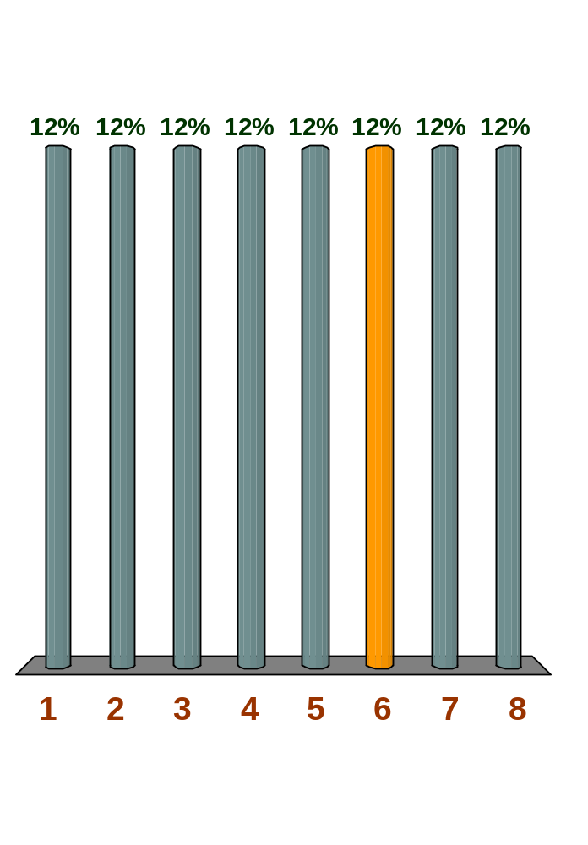
Q The diagram shows the market for cocoa. Equilibrium is currently at point x. To which equilibrium point
(1, 2, 3, 4, 5, 6, 7 or 8) will the market move if there is a rise in wages in the chocolate industry?

Slide 70
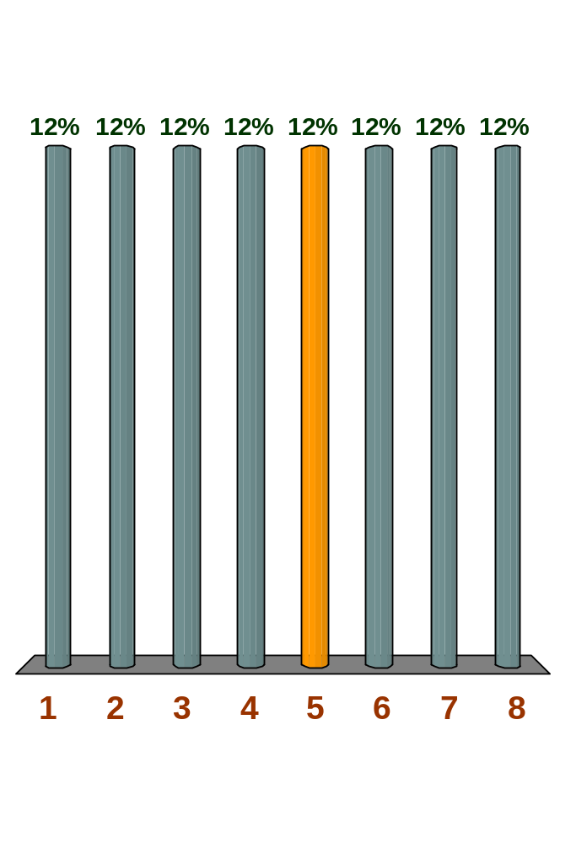
Q The diagram shows the market for cocoa. Equilibrium is currently at point x. To which equilibrium point
(1, 2, 3, 4, 5, 6, 7 or 8) will the market move if there is speculation that the price of cocoa will fall?

Slide 71
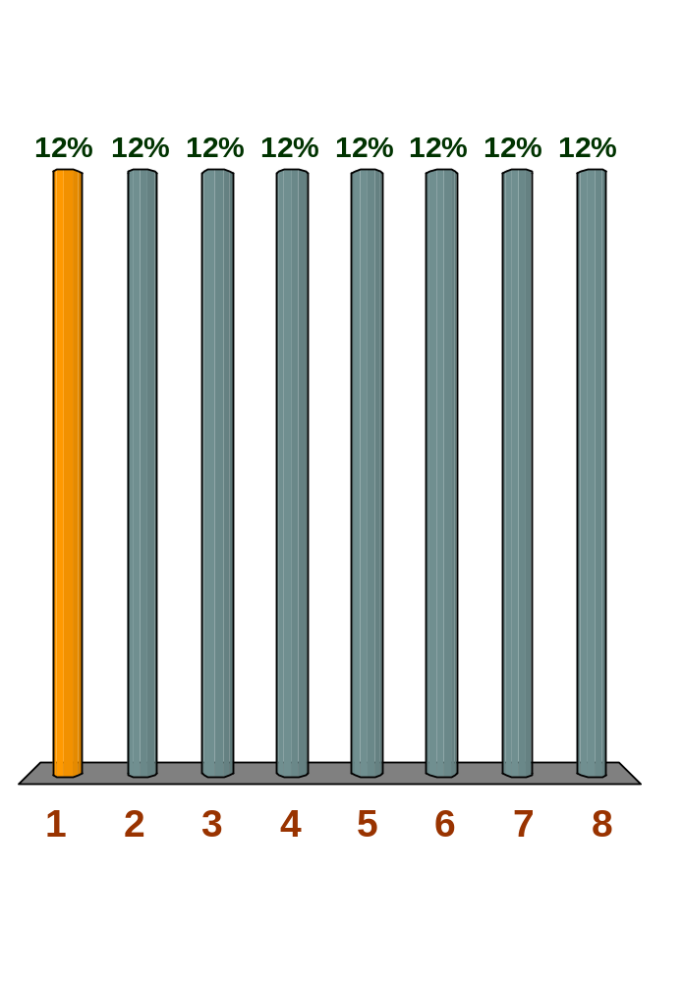
Q The diagram shows the market for cocoa. Equilibrium is currently at point x. To which equilibrium point (1, 2, 3, 4, 5, 6, 7 or 8) will the market move if there is increased demand for chocolate and a new tax on cocoa?

Slide 72
Problems in identifying the position and shape of the demand curve: shift in supply and demand curves
P
S₂
S₁
30p
b
Shift in both supply and demand.
20p
a
D₂
D₁
O
800
1000
Q

Slide 73
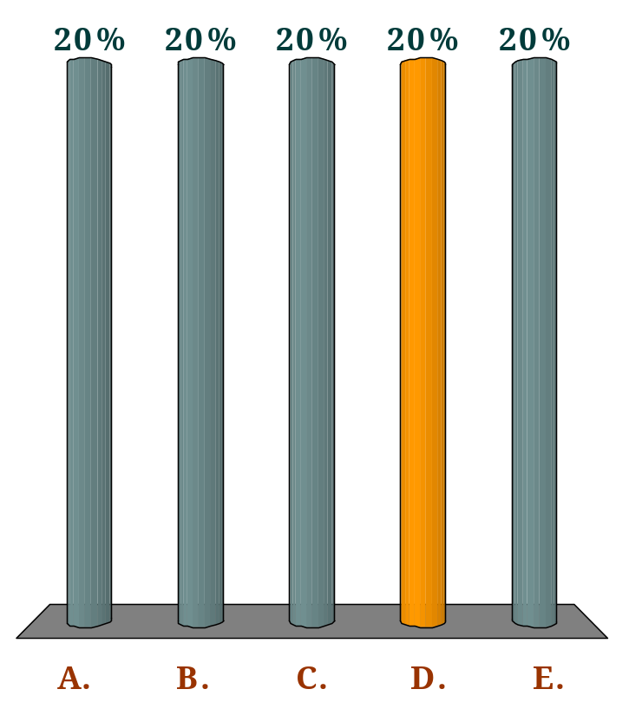
If it is observed that the price and quantity of a product sold both fall, we can conclude that:
Q
demand has shifted to the right, but we cannot draw any conclusions about supply without more information.
demand has shifted to the left, but we cannot draw any conclusions about supply without more information.
supply has shifted to the right, but we cannot draw any conclusions about demand without more information.
supply has shifted to the left, but we cannot draw any conclusions about demand without more information.
We cannot draw any conclusions about shifts in either curve without more information.

Slide 74
The Control of Prices
The free working of the market will always establish equilibrium price and quantity.
At the equilibrium, there will be no shortage or surplus.
However, the equilibrium price and quantity may not be the most desirable. Government may therefore enter the market and fix a price that may be above or below the equilibrium price.
There are two kinds:
Minimum Price control, or Price Floor
Maximum Price control, or price ceiling

Slide 75
Minimum Price Control
Minimum Price or price Floor establishes a minimum legal price below which the commodity cannot be sold.
When a minimum price is established, it means that the price is not allowed to fall below that level.
Example: Minimum wage
Notes:
2

Slide 76
Reasons for Minimum Price Control
To protect producers income
To create surplus in periods of excess production which can be stored in preparation for future shortages
To protect workers income in the case of minimum wage

Slide 77
Minimum price: price floor
P
S
P_{e}
D
O
Q

Slide 78
Minimum price: price floor
P
S
surplus
minimum
price
P_{e}
D
O
Q_{d}
Q_{s}
Q

Slide 79
Dealing with resulting surpluses
Government could buy the surplus and sell it later or sell it abroad
Supply could be artificially lowered by government restrictions
Demand could be raised by advertisement, finding alternative uses, or by reducing consumption especially imports

Slide 80
Maximum Price Control
A price ceiling establishes a maximum price that sellers are legally permitted to charge.
Sellers are not allowed to sell above the maximum price
Example: Rent, Fuel prices in Ghana
Maximum prices are set to protect consumers especially for essential commodities.
Notes:
2

Slide 81
Maximum price: price ceiling
P
S
P_{e}
D
O
Q

Slide 82
Maximum price: price ceiling
P
S
P_{e}
maximum
price
shortage
D
O
Q_{s}
Q_{d}
Q

Slide 83
Effects of Maximum Price Control
  Shortage
  Underground markets (Parallel or Black Market).
  Quantity produced may fall worsening the shortage

Slide 84
Dealing with the Shortages
  Government can encourage supply
  Direct production by government
  Discourage demand
  Encourage production of alternative goods
  Controlling people’s income

Slide 85
Effect of price control on underground-market prices
P
S
No underground market
P_{e}
Price ceiling
P_{g}
D
O
Q_{s}
Q_{d}
Q

Slide 86

Effect of price control on underground-market prices
P
S
P_{b}
If operators in underground markets buy all the supplies at P_{g}, the black market equilibrium price will be P_{b}.
P_{e}
P_{g}
D
O
Q_{s}
Q_{d}
Q

Slide 87
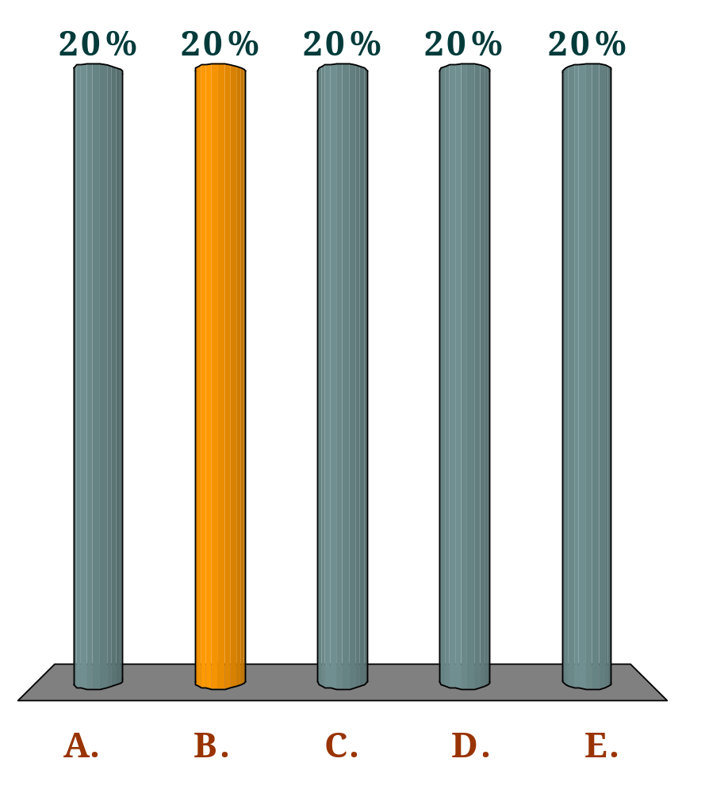
Which one of the following controls would involve setting a minimum price rather than a maximum price of a good (or factor)?
Q
Controls on rents to protect tenants on low incomes.
Controls on wages to protect workers on low incomes.
Controls on basic food prices to protect consumers on low incomes.
Controls on transport fares to protect passengers on low incomes.
None of the above.

Slide 88

If the government raises the minimum wage (relative to other wage rates):
Q
unemployment would fall.
wage rates in higher-paid jobs would fall.
the demand for workers at the minimum wage would rise.
the supply of workers at the minimum wage would rise.
there would be a smaller disequilibrium at the minimum wage than before.

Slide 89
The market for text books is currently in equilibrium. The following are some changes that may take place in the market for textbooks. For each of the following, indicate what will happen to either the demand for or the supply of textbooks by listing which curve is affected and then the terms: "shift right or "shift left" and show it graphically. (NOTE: START FROM THE INITIAL EQUILIBRIUM)
An increase in student enrolment at universities across the country
A decrease in the price of ink used to print textbooks
A drop in income (textbooks are a normal good).
An improvement in the technology used to print textbooks

Slide 90
If you were working full-time now, you could earn GH¢20,000 per year. Instead, you are working part-time while going to school. In your current part-time job, you earn GH¢5,000 per year. At your school, the annual cost of tuition, books, and other fees is GH¢2,000. The opportunity cost of completing your education is:
GH¢2,000
GH¢5,000
GH¢17,000
GH¢20,000
GH¢22,000

